Slide 1
Building a java web application - 1
Java in practice
November 29, 2016

Slide 2
Encryption in Java
Agenda for today
Apache Tomcat Server
Servlets
JSP
Packaging

Slide 3

Apache Tomcat Server
An open source Java Servlet container which implements JAVA EE specifications like Java Servlet, JavaServer Pages(JSP), Java EL, web sockets and provides “pure Java” HTTP web server.
Components:
Catalina – the Tomcat’s servlet container
Coyote – the connector component which supports HTTP protocol
Japser – the Tomcat’s JSP engine

Slide 4
Servlet overview
Java class which conforms Servlet API, a standard for implementing java classes that responds to requests.
Servlets can add dynamically content to a web page.
Content is commonly HTML but it could be any other data such as XML.
Servlets are run by web containers such as Tomcat. The web container is responsible for the life cycle of the servlets as well as mapping particular URL to a servlet and ensuring that the URL requestor has the appropriate access rights.

Slide 5
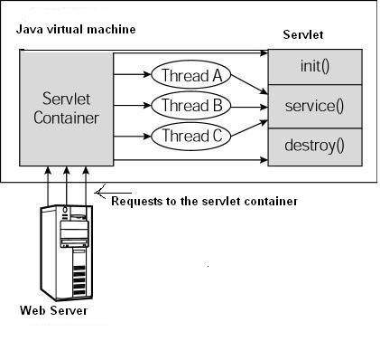
Servlet life cycle
Requests are delegated to the servlet container
The container loads the servlet before invoking the service method
The servlet container handles multiple
requests by spawning multiple
threads and each thread is
invoking the service method

Slide 6
Servlet life cycle
init() – the servlet is initialized by this method. It is called only once.
service() – method is called to process the client’s request. Each time the client request for a servlet, the server spawns a new thread and calls service(). The method checks the type GET, POST, DELETE etc. and it calls the corresponding method doGet(), doPost(), doDelete(). Usually this method is never overridden instead you override the doGet, doPost etc.
destroy() – the servlet is terminated by calling destroy() method. This method is called only once at the end of the lifecycle of the servlet.

Slide 7
Servlet example
import java.io.*;
Import javax.servlet.*;
Import javax.servlet.http.*;
Public class Hello extends HttpServlet{
private String message;
public void init() throws ServletException {
message = “Hello World!”;
}
public void doGet(HttpServletRequest request, HttpServletResponse response) throws ServletException, IOException {
response.setContentType(“text/html”);
PrintWriter out = response.getWriter();
out.println(“<h1>” + message + “</h1>”);
}
public void destroy(){
// do nothing
}

Slide 8
Resources
Tomcat Server 8.05:
http://tomcat.apache.org/download-80.cgi
JDK 7 or 8:
http://www.oracle.com/technetwork/java/javase/downloads/

Slide 9
Application layout (WAR file structure)
*.html, *.jsp ect. – HTML JSP pages that will be visible on the client browser.
/WEB-INF/web.xml – The web application deployment descriptor of the web application. It describes servlets and other components, initialization parameters, container-managed security context that needs to be enforced over the application.
/WEB-INF/classes – this directory contains java classes required for the application. It may contains any classes servlet as well as non-servlet ones.
/WEB-INF/lib – this directory contains JAR files required by the application.

Slide 10
Java Server Pages (JSP)
A technology for developing web pages that support dynamic content. It supports special JSP tags, most of which start with <% and end with %>. It allows to mix static with dynamically generated HTML.
They can be used to collect and manipulate user data input, present records from data base or another source etc.

Slide 11
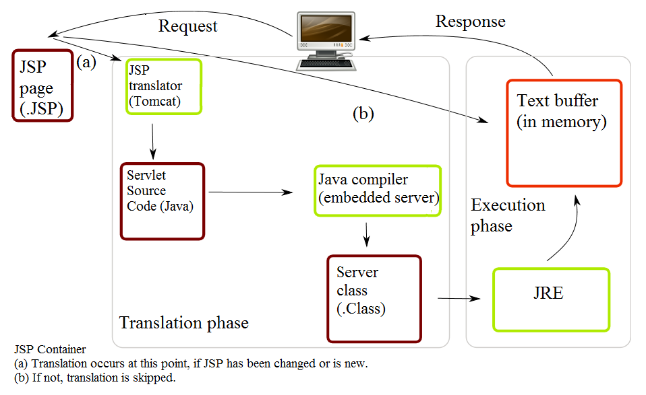
JSP processing

Slide 12
JSP processing
A browser sends request to the web server
The web server recognizes the JSP request and forwards it to JSP engine.
The JSP engine loads the JSP page and converts it to servlet content.
The engine compiles the servlet into executable class and forwards the origin request to the servlet engine.
The servlet engine loads the class file and executes it. The servlet process an output in HTML format and forwards it to the web server inside an HTTP response.
The web server forwards the response to the client
The client visualizes the content.

Slide 13
JSP syntax
The scriptlet may contain any number of java language statements, variables or method declarations, or expressions.
Scriptlet syntax:
<% code fragment %>
Any text, HTML tags must be outside the scriptlet.
<html>
<head><title>Hello World</title></head>
<body>
Hello World!<br/>
<%
out.println("Your IP address is " + request.getRemoteAddr());
%>
</body>
</html>

Slide 14
JSP declarations
A declaration declares one or more variables which can be used later in the JSP
Syntax:
<%! declaration; [ declaration; ]+ ... %>
Example:
<%! int i = 0; %>
<%! int a, b, c; %>
<%! Circle a = new Circle(2.0); %>

Slide 15
JSP expressions
The JSP expression contains a scripting language expression that is evaluated, converted to string and inserted where the expression appears in the JSP file.
Syntax:
<%= expression %>
Example:
<html>
<head><title>A Comment Test</title></head>
<body>
<p>
Today's date: <%= (new java.util.Date()).toLocaleString()%>
</p>
</body>
</html>

Slide 16
JSP directives
Affects the overall structure of the servlet class.
Syntax:
<%@ directive attribute="value" %>
Three type of directives
<%@ page ... %> - Defines page-dependent attributes, scripting language, error page
<%@ include ... %> - Includes a file during translation phase
Example: <%@ include file="relative url" >
<%@ taglib ... %> - declares a tag library, containing custom actions, used in the page.
Example: <%@ taglib uri="uri" prefix="prefixOfTag" >
<prefixOfTag:hello>

Slide 17
JSP page directives attributes
buffer – specifies a buffering model for the output stream
autoFlush – controls the behavior of the servlet output buffer
contentType – defines the character encoding schema
errorPage – Defines the URL of another JSP that reports on Java unchecked runtime exceptions.
isErrorPage - Indicates if this JSP page is a URL specified by another JSP page's errorPage attribute.
extends - Specifies a superclass that the generated servlet must extend.
isThreadSafe - Defines the threading model for the generated servlet.
import - Specifies a list of packages or classes for use in the JSP as the Java import statement does for Java classes.
session - Specifies whether or not the JSP page participates in HTTP sessions

Slide 18
JSP directives exercise
Define a header JSP which counts the visits of the page.
Define a footer JSP
Combine the header and footer in main.jsp

Slide 19
JSP or Servlet?
When we should use JSP and when we should use Servlet?

Slide 20
JSP or Servlet?
JSP is compiled to servlet the first time it is run. This means that there is no real run time differences between the JSP and the servlet. The most tradition way the servlets are used are as controllers and JSPs as views. JSP should not contain any business logic or database connections inside. They should be used only to present the data to the user.

Slide 21

Questions?

Slide 22
Homework
Basic Tomcat application part 1
Develop an account registration form which submits its data to a servlet. Let the registration properties be the same as those defined in the AccountBean from the address book project. Add an additional password and creation date fields.
Save the submitted data to a file in the application folder.
If the data is successfully persisted, redirect to success page.
If error occurs redirect to an error page.
Package the application in a WAR file.

Slide 23
Thanks for your attention!
Petya Karastoyanova
pkarastoyanova@axway.com

